Slide 1
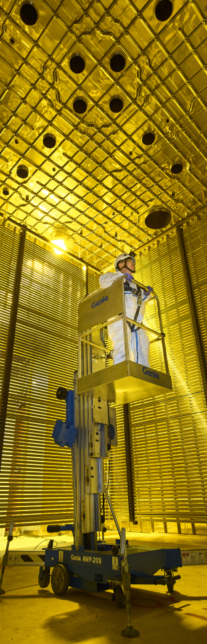
Beam monitoring for the dune experiment with the sand detector
Presenta: Federico Battisti Relatore: Prof. Sergio Bertolucci Correlatore: Dott. Matteo Tenti

Slide 2
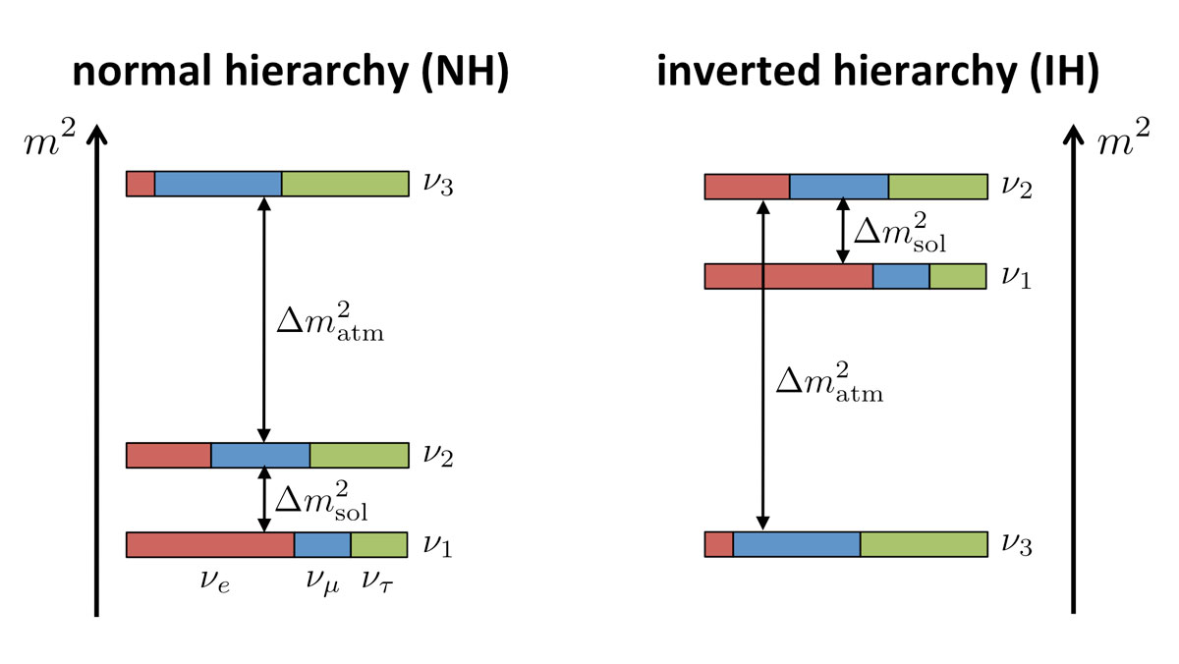
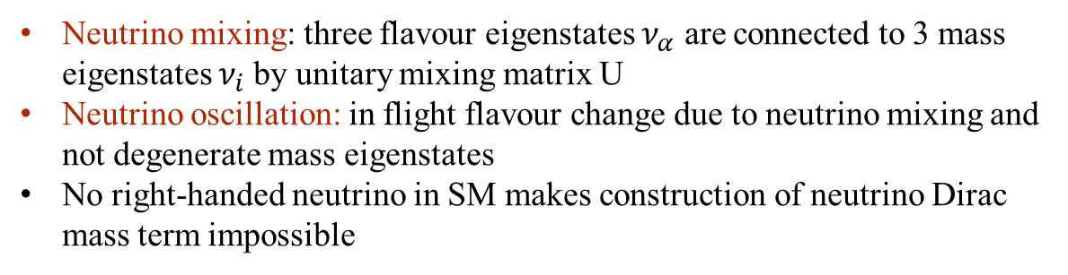
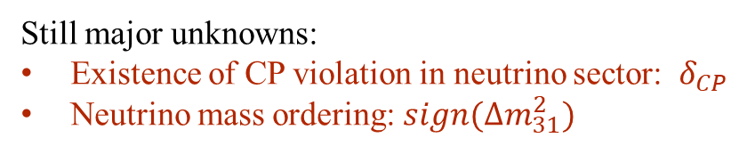
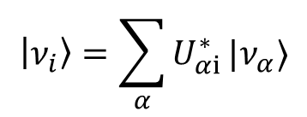
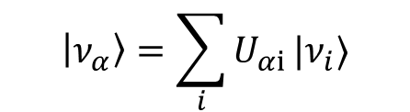
Neutrino oscillations
Neutrino mixing: three flavour eigenstates $ν_{α}$ are connected to 3 mass eigenstates $ν_{i}$by unitary mixing matrix U
Neutrino oscillation: in flight flavour change due to neutrino mixing and not degenerate mass eigenstates
No right-handed neutrino in SM makes construction of neutrino Dirac mass term impossible
$$\left|ν_{α}\right\rangle =\sum_{i}{U_{αi}}|ν_{i}⟩$$
$$\left|ν_{i}\right\rangle =\sum_{α}{U_{αi}^{∗}}|ν_{α}⟩$$
Neutrino oscillations require extension of the SM
Still major unknowns:
Existence of CP violation in neutrino sector: $δ_{CP}$
Neutrino mass ordering: $sign(Δm_{31}^{2})$

Slide 3
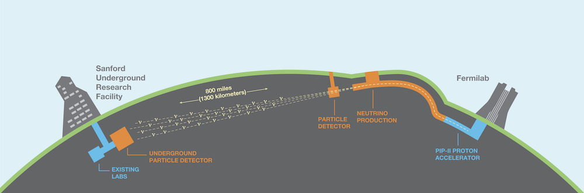
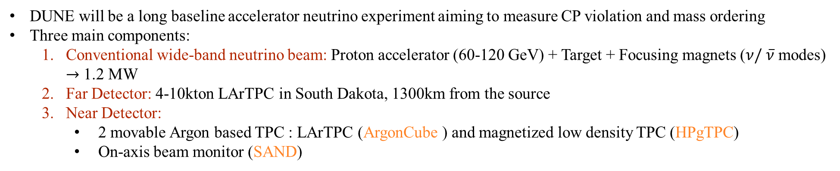
DUNE: deep underground neutrino experiment
NEAR DETECTOR
FAR DETECTOR
DUNE will be a long baseline accelerator neutrino experiment aiming to measure CP violation and mass ordering
Three main components:
Conventional wide-band neutrino beam: Proton accelerator (60-120 GeV) + Target + Focusing magnets ($ν/ \overline{ν}$ modes) $→$ 1.2 MW
Far Detector: 4-10kton LArTPC in South Dakota, 1300km from the source
Near Detector:
2 movable Argon based TPC : LArTPC (ArgonCube ) and magnetized low density TPC (HPgTPC)
On-axis beam monitor (SAND)

Slide 4
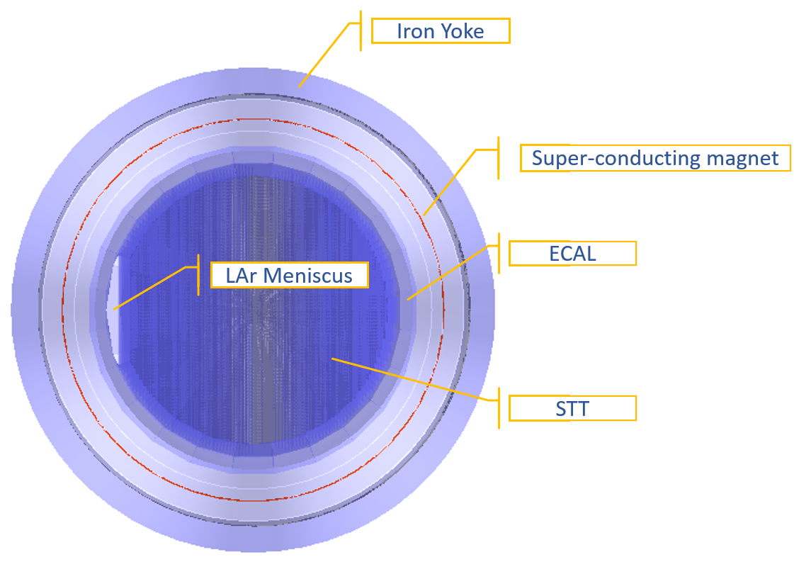
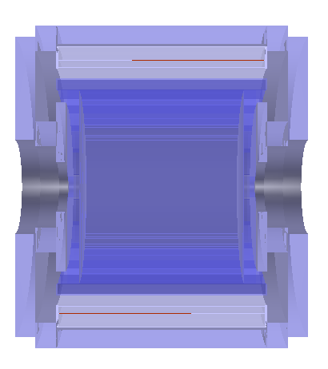
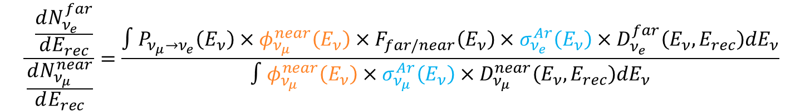
Sand: system for on-axis neutrino detection
Based on KLOE detector: iron structure, super-conducting magnet and electro-magnetic calorimeter (ECAL).
Internal tracker yet to be defined: we considered STT (straw tube tracker)
$$\frac{ \frac{dN_{ν_{e}}^{far}}{dE_{rec}}}{\frac{dN_{ν_{μ}}^{near}}{dE_{rec}}}=\frac{∫P_{ν_{μ}→ν_{e}}\left(E_{ν}\right)×φ_{ν_{μ}}^{near}\left(E_{ν}\right)×F_{far/near}\left(E_{ν}\right)×σ_{ν_{e}}^{Ar}\left(E_{ν}\right)×D_{ν_{e}}^{far}\left(E_{ν},E_{rec}\right)dE_{ν}}{∫φ_{ν_{μ}}^{near}\left(E_{ν}\right)×σ_{ν_{μ}}^{Ar}\left(E_{ν}\right)×D_{ν_{μ}}^{near}\left(E_{ν},E_{rec}\right)dE_{ν}}$$

Slide 5
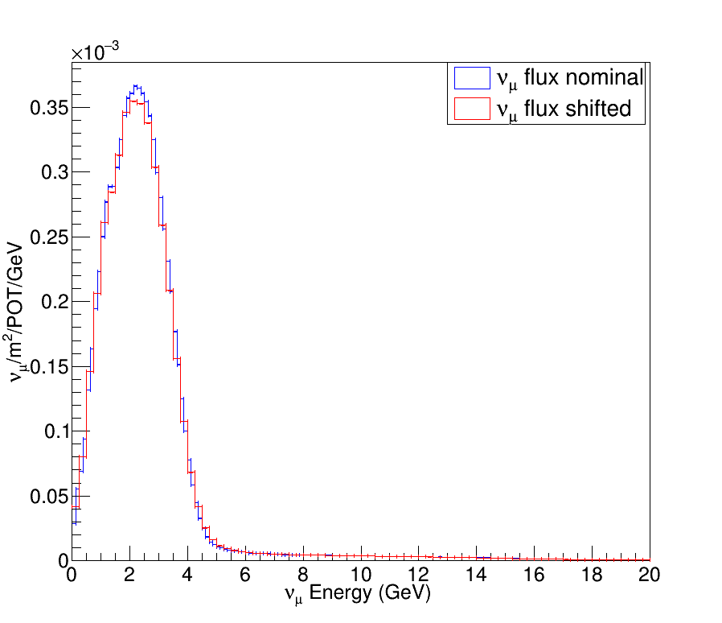
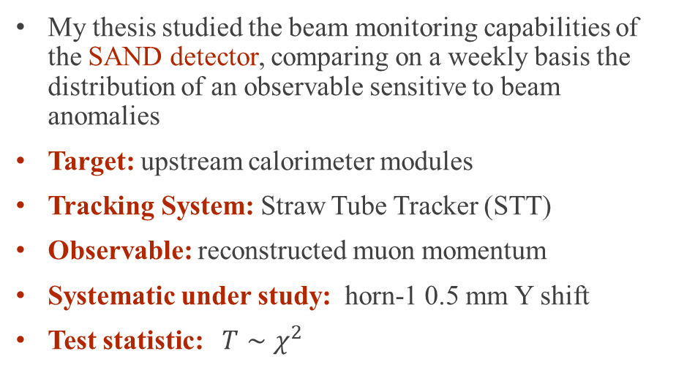
Beam monitoring
My thesis studied the beam monitoring capabilities of the SAND detector, comparing on a weekly basis the distribution of an observable sensitive to beam anomalies
Target: upstream calorimeter modules
Tracking System: Straw Tube Tracker (STT)
Observable: reconstructed muon momentum
Systematic under study: horn-1 0.5 mm Y shift
Test statistic: ${T∼χ}^{2}$
Note: we call nominal and shifted the results obtained with standard and horn-1 displaced neutrino beam respectively

Slide 6
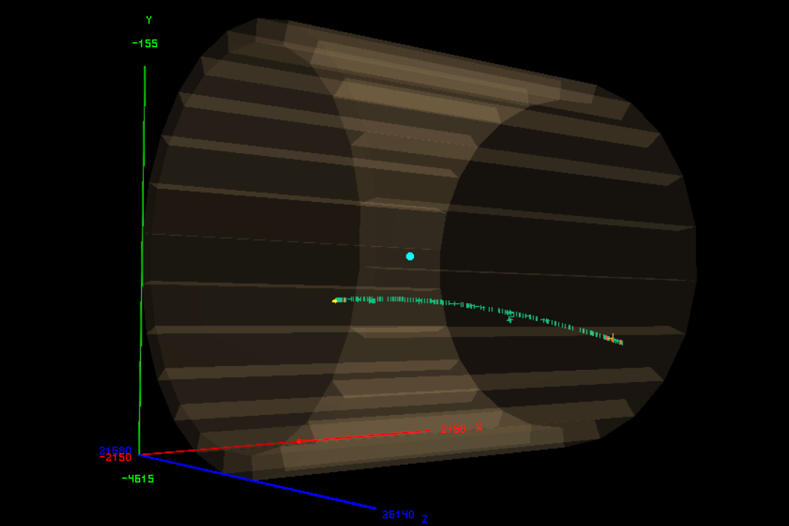
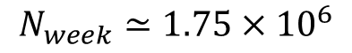
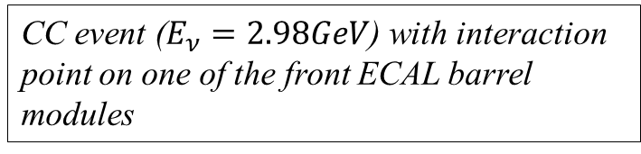
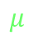
Geometry and interaction simulation
Geometry: dunendggd (Near Detector (ND) group specific software)
Neutrino interactions: GENIE (neutrino Monte Carlo generator)
Particle propagation: edep-sim (Geant4 based software)
ECAL barrel
Interaction Point
$$μ$$
Straw Tubes Hits
CC event ($E_{ν}=2.98GeV$) with interaction point on one of the front ECAL barrel modules
One week’s worth of statistics on the 9 up-stream calorimeter barrel modules
$$N_{week}≃1.75×{10}^{6}$$

Slide 7
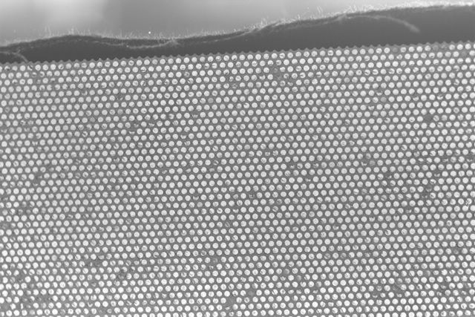
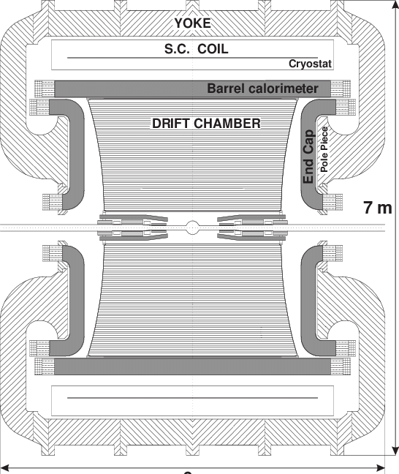
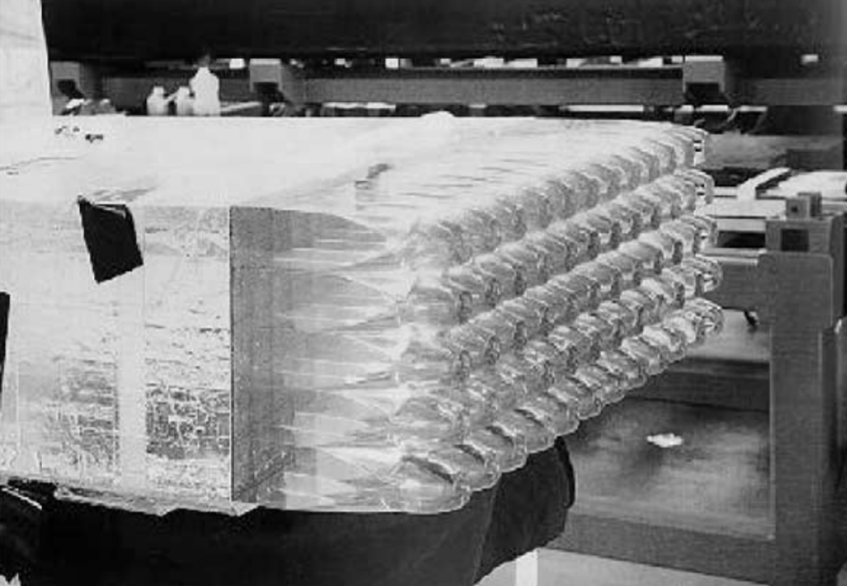
ecal: structure
FIBERS
Spaghetti calorimeter with lead and scintillating fibers
READ-OUT
Groups of scintillating fibers are read-out on both side by photo-multiplier tubes (PMT) through light guides

Slide 8
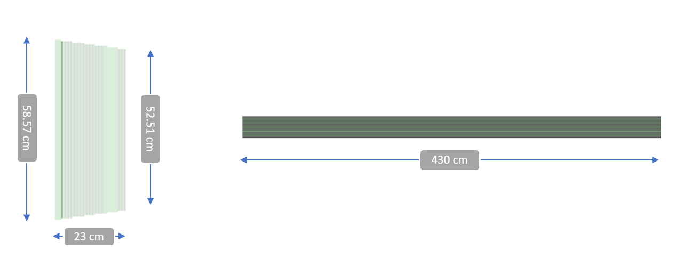
ecal: structure
BARREL
Calorimeter Barrel: segmented into twenty-four trapezoidal modules 4.3 m long, 23 cm thick and bases of 52 and 59 cm.
Approximation: 209 alternating slabs of plastic scintillator (0.07cm) and lead (0.04cm)

Slide 9
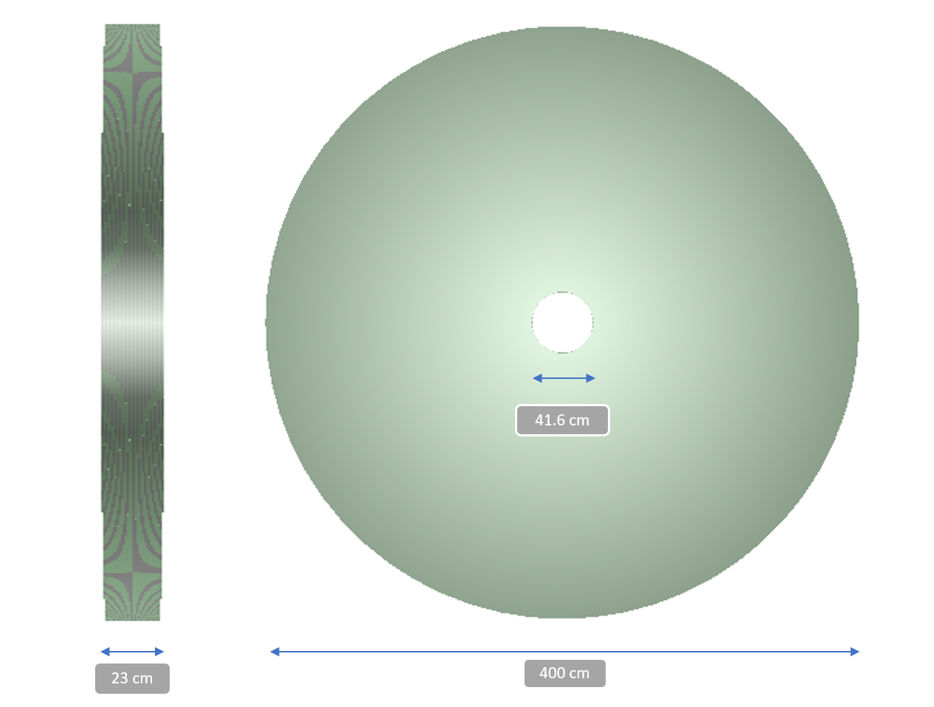
ecal: structure
END-CAPS
Calorimeter End-caps: complex geometry with vertical modules bent horizontally to fit PMs
Approximation: hollow cylinders of inner diameter 41.6 cm and outer diameter 400 cm

Slide 10
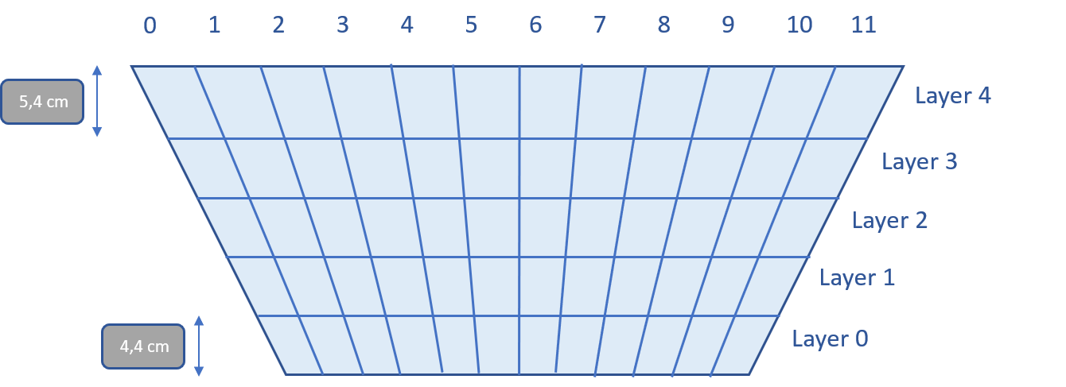
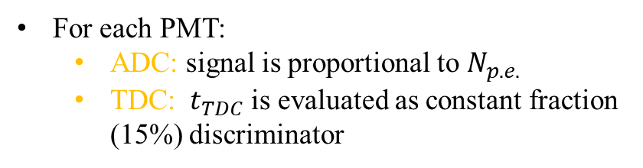
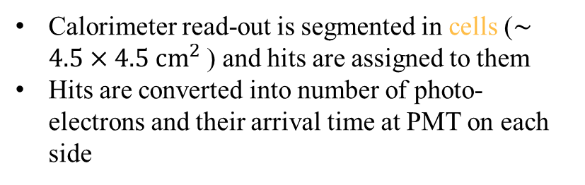
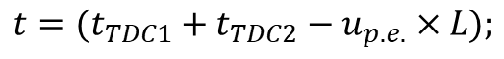
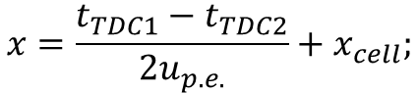
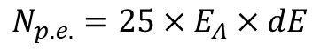
Ecal: digitization and reconstruction
DIGITIZATION
Calorimeter read-out is segmented in cells ($∼4.5×4.5 {cm}^{2}$) and hits are assigned to them
Hits are converted into number of photo-electrons and their arrival time at PMT on each side
CELLS
$$N_{p.e.}=25×E_{A}×dE$$
$$t_{p.e.}=t_{part}+t_{decay}+d⋅u_{ph}+Gauss(1ns )$$
RECONSTRUCTION
The particle arrival time t and its coordinate x along the fiber direction are evaluated as:
For each PMT:
ADC: signal is proportional to $N_{p.e.}$
TDC: $t_{TDC}$is evaluated as constant fraction (15%) discriminator
$$x=\frac{t_{TDC1}−t_{TDC2}}{2u_{p.e.}}+x_{cell};$$
$$t=(t_{TDC1}+t_{TDC2}−u_{p.e.}×L);$$

Slide 11
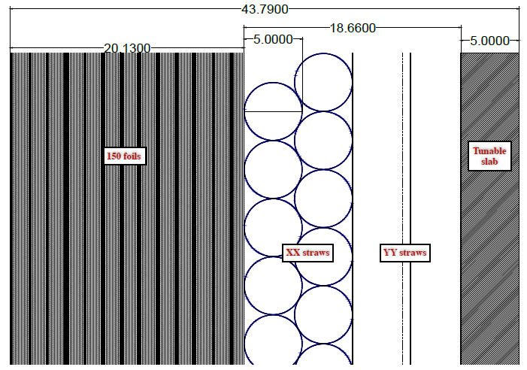
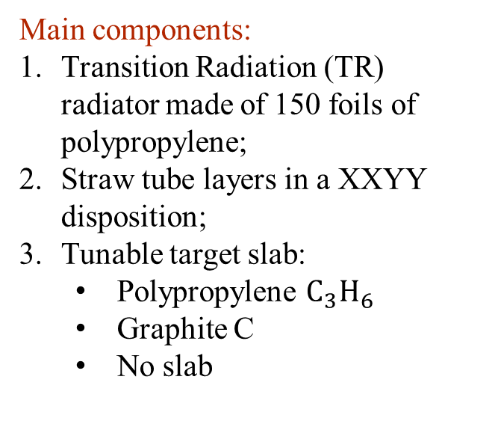
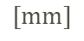
STT: structure
$$[mm]$$
MODULE
Main components:
Transition Radiation (TR) radiator made of 150 foils of polypropylene;
Straw tube layers in a XXYY disposition;
Tunable target slab:
Polypropylene $C_{3}H_{6}$
Graphite C
No slab
90 total modules. Proceeding downstream: 85 modules alternated between the 78 polypropylene ones and the 7 graphite ones + 5 slabless

Slide 12
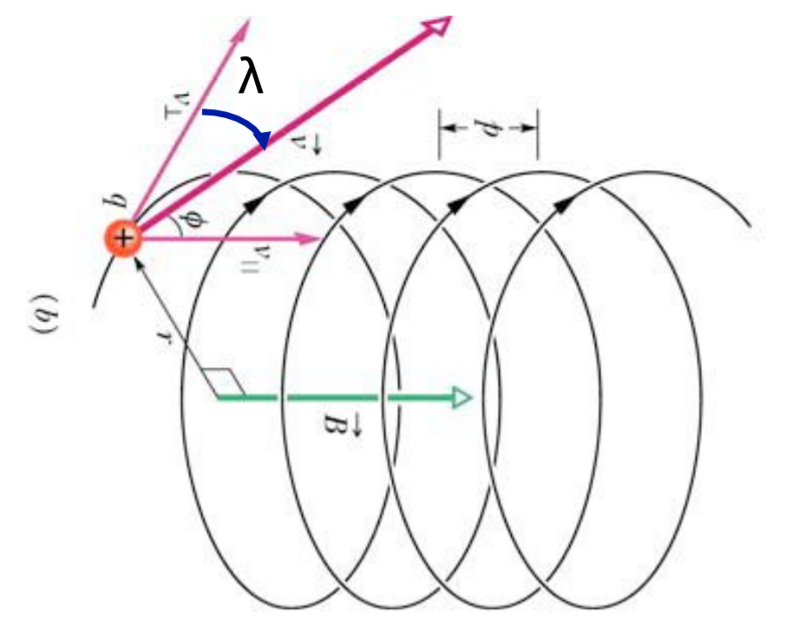
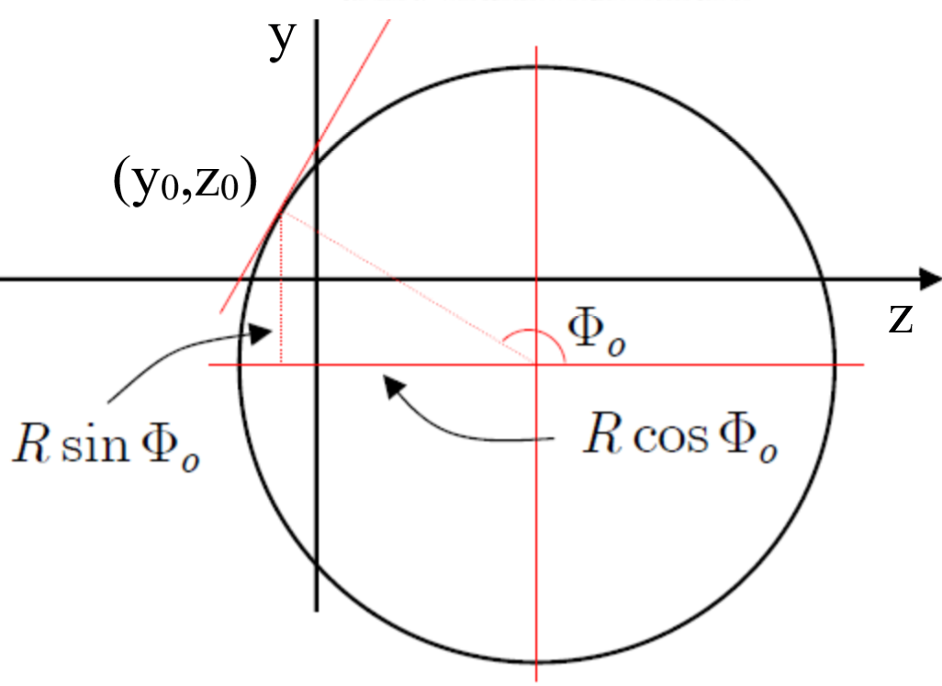
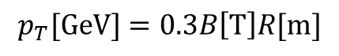
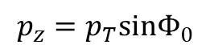
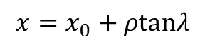
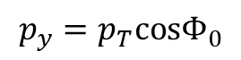
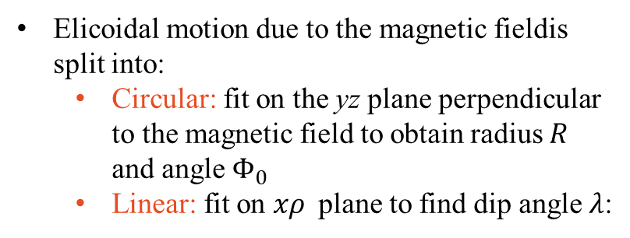
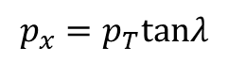
Stt: digitization and reconstruction
DIGITIZATION
RECONSTRUCTION
Straw tubes provide:
Transversal position and time of the passage of the particles
Their energy deposit
Elicoidal motion due to the magnetic fieldis split into:
Circular: fit on the yz plane perpendicular to the magnetic field to obtain radius $R$ and angle $Φ_{0}$
Linear: fit on $xρ$plane to find dip angle $λ$:
$$x=x_{0}+ρtanλ$$
Transverse momentum:
$$p_{T}[GeV]=0.3B\left[T\right]R[m]$$
Momentum components:
$$p_{x}=p_{T}tanλ$$
$$p_{y}=p_{T}cosΦ_{0}$$
$$p_{z}=p_{T}sinΦ_{0}$$

Slide 13

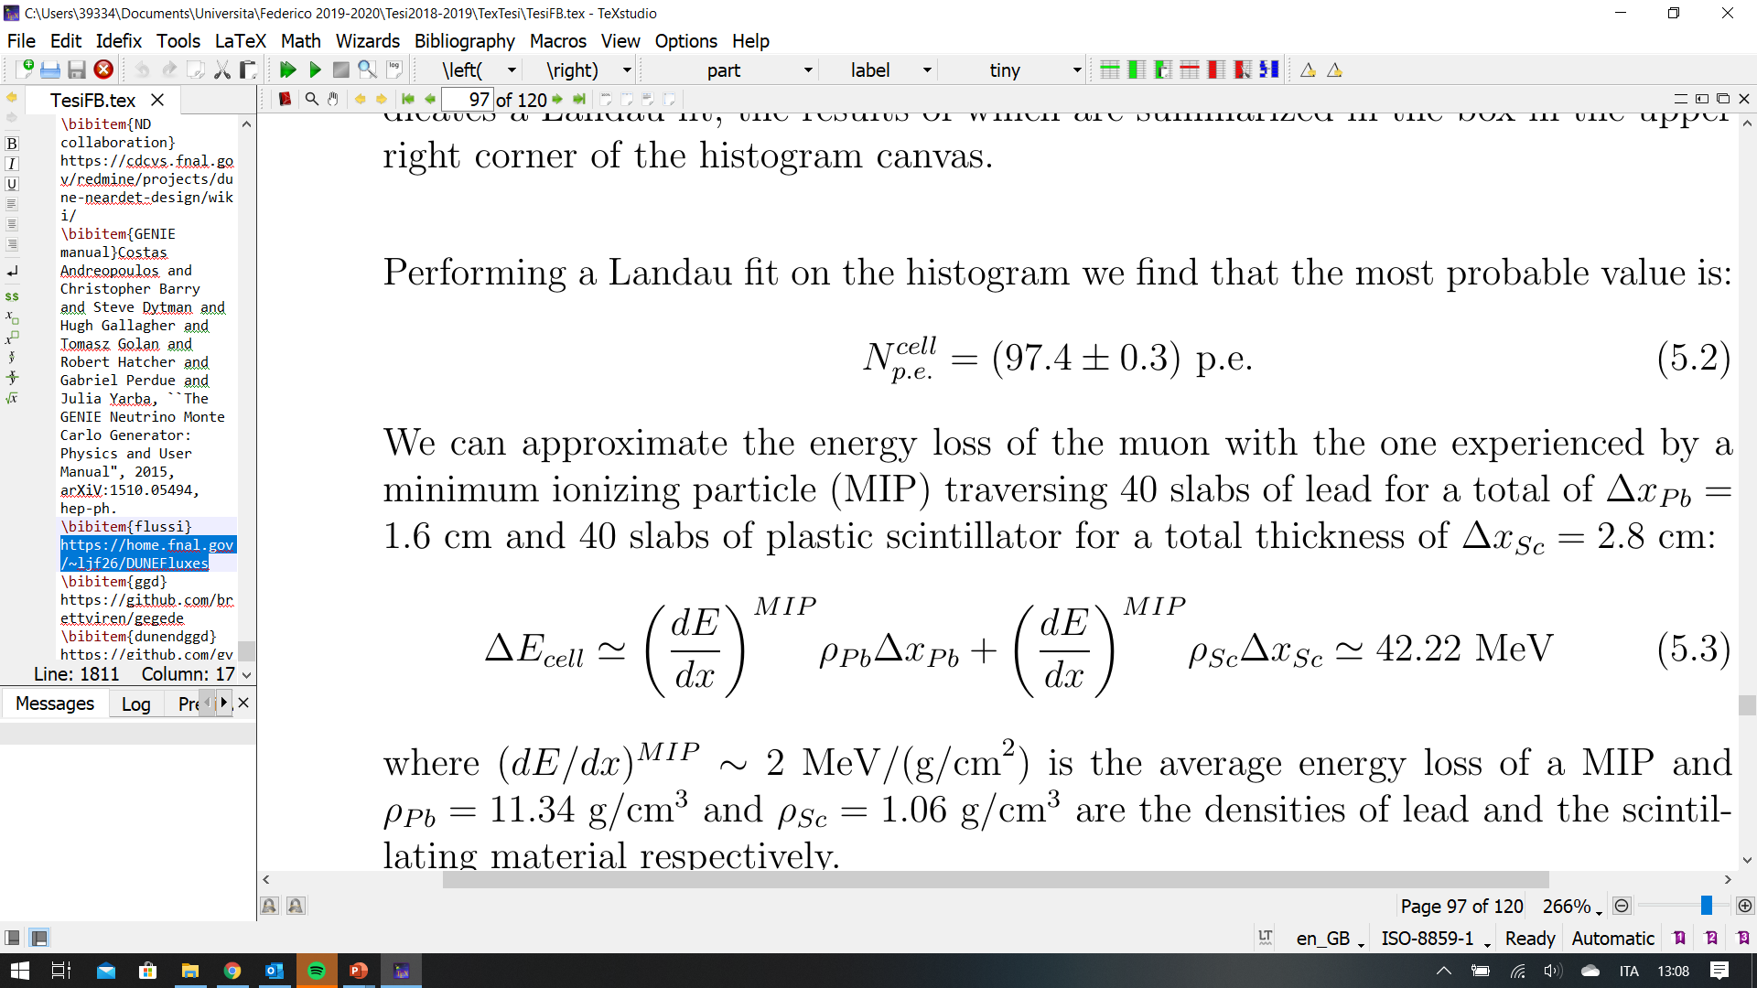
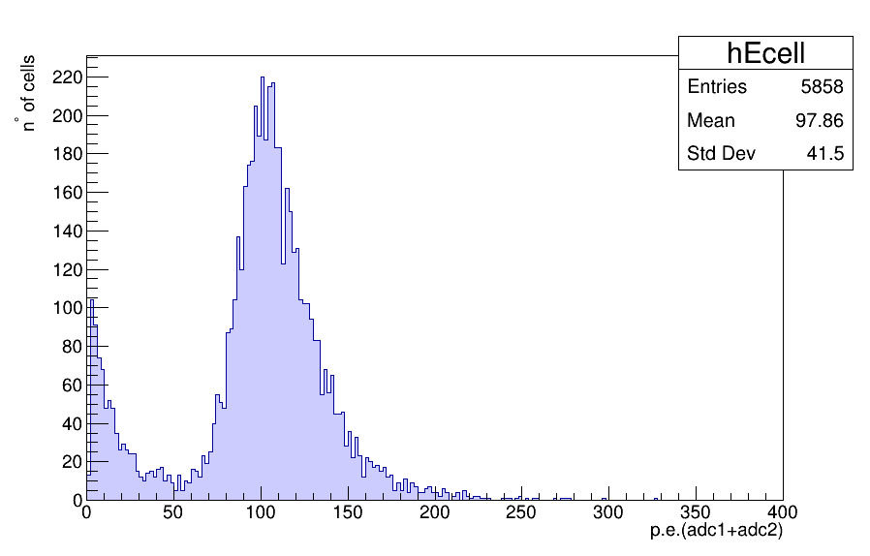
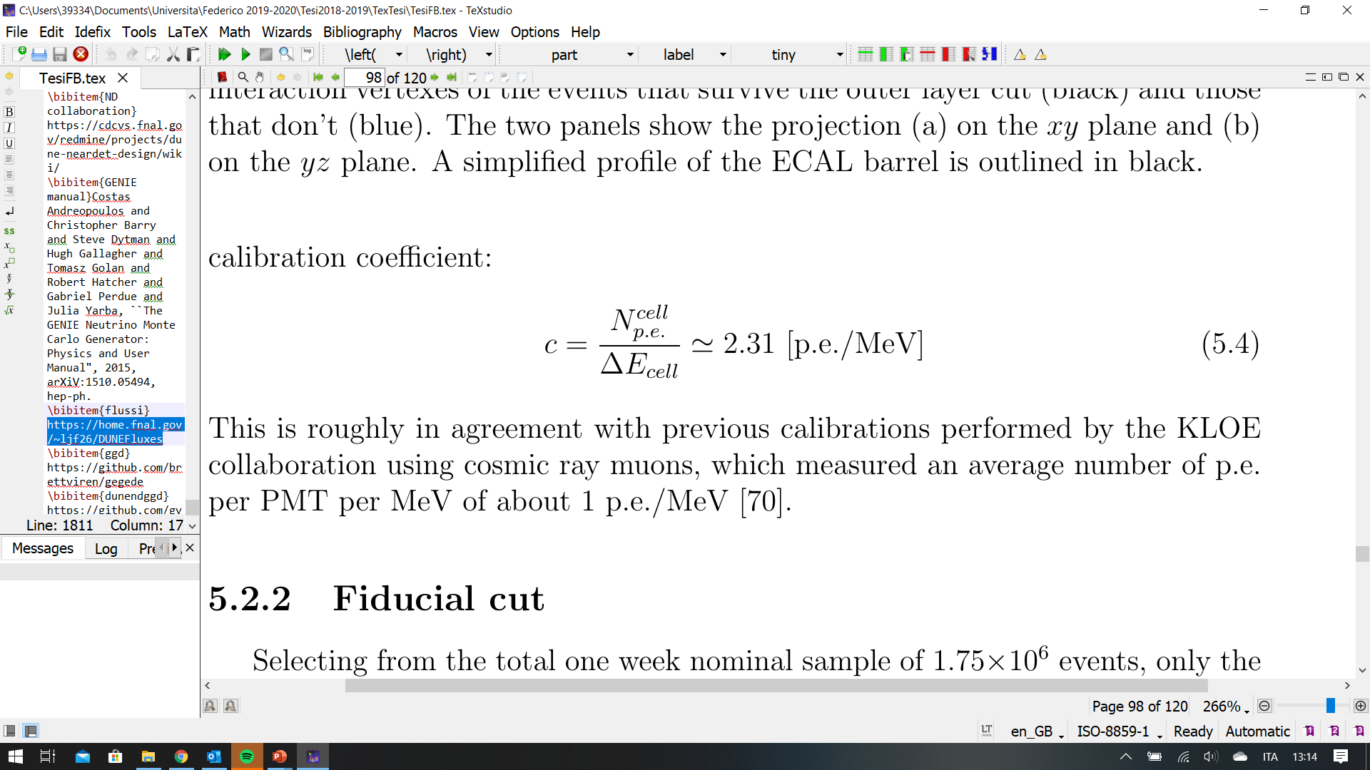
Preliminary measurement: light yield
Simulated 1000 muons at 10 GeV passing through an ECAL barrel module

Slide 14
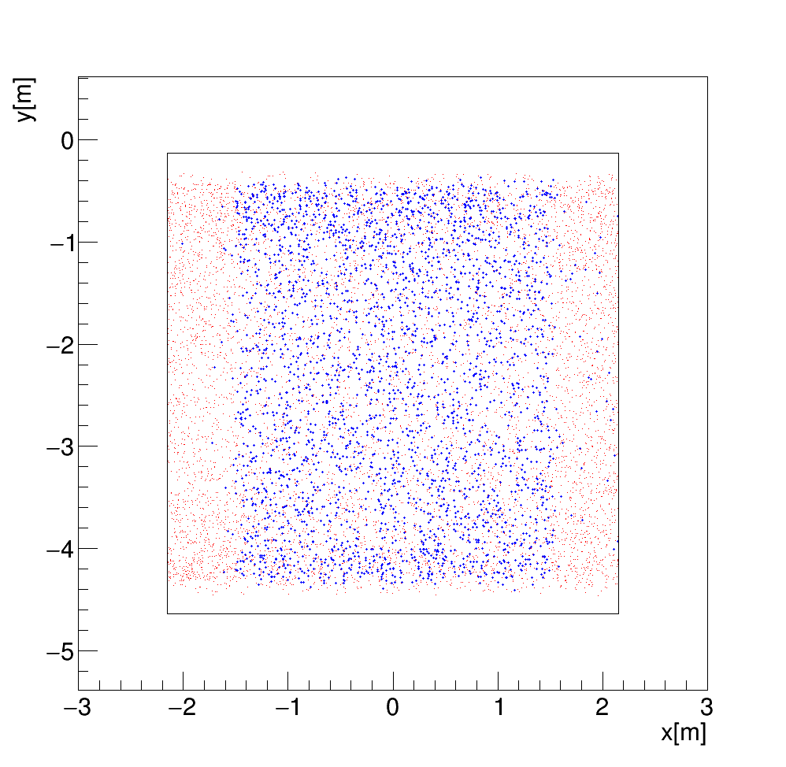
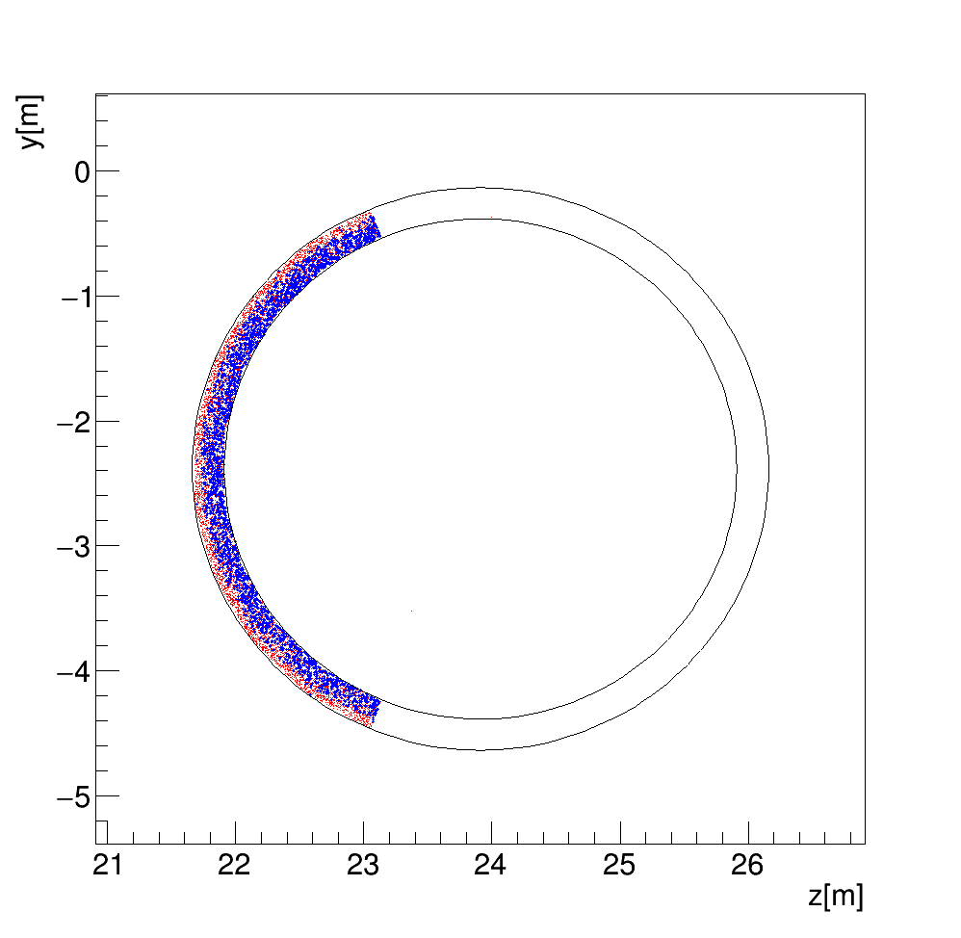
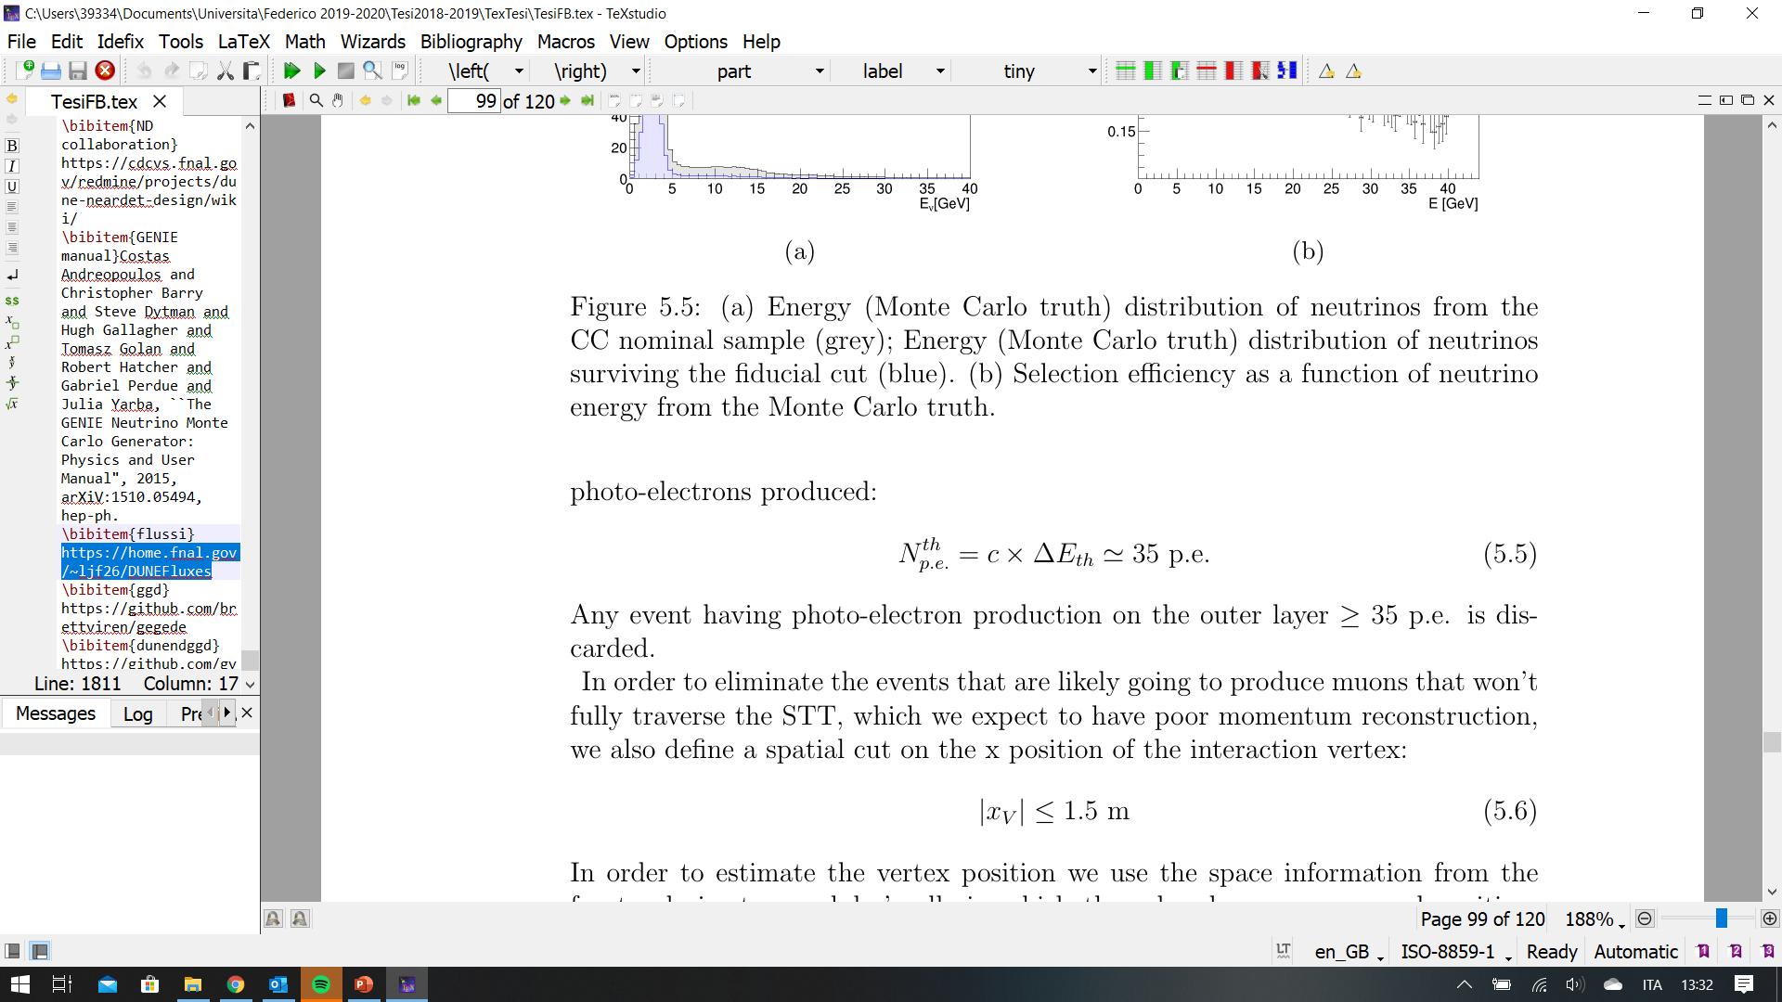
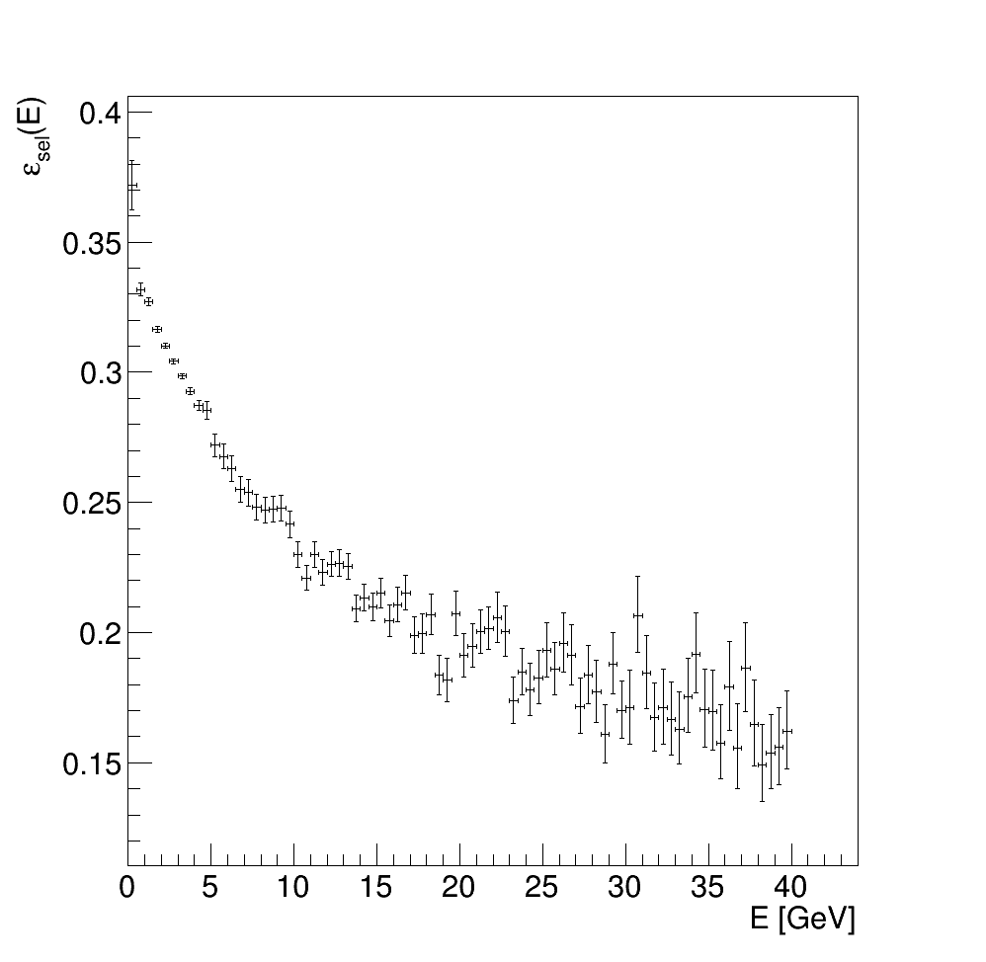
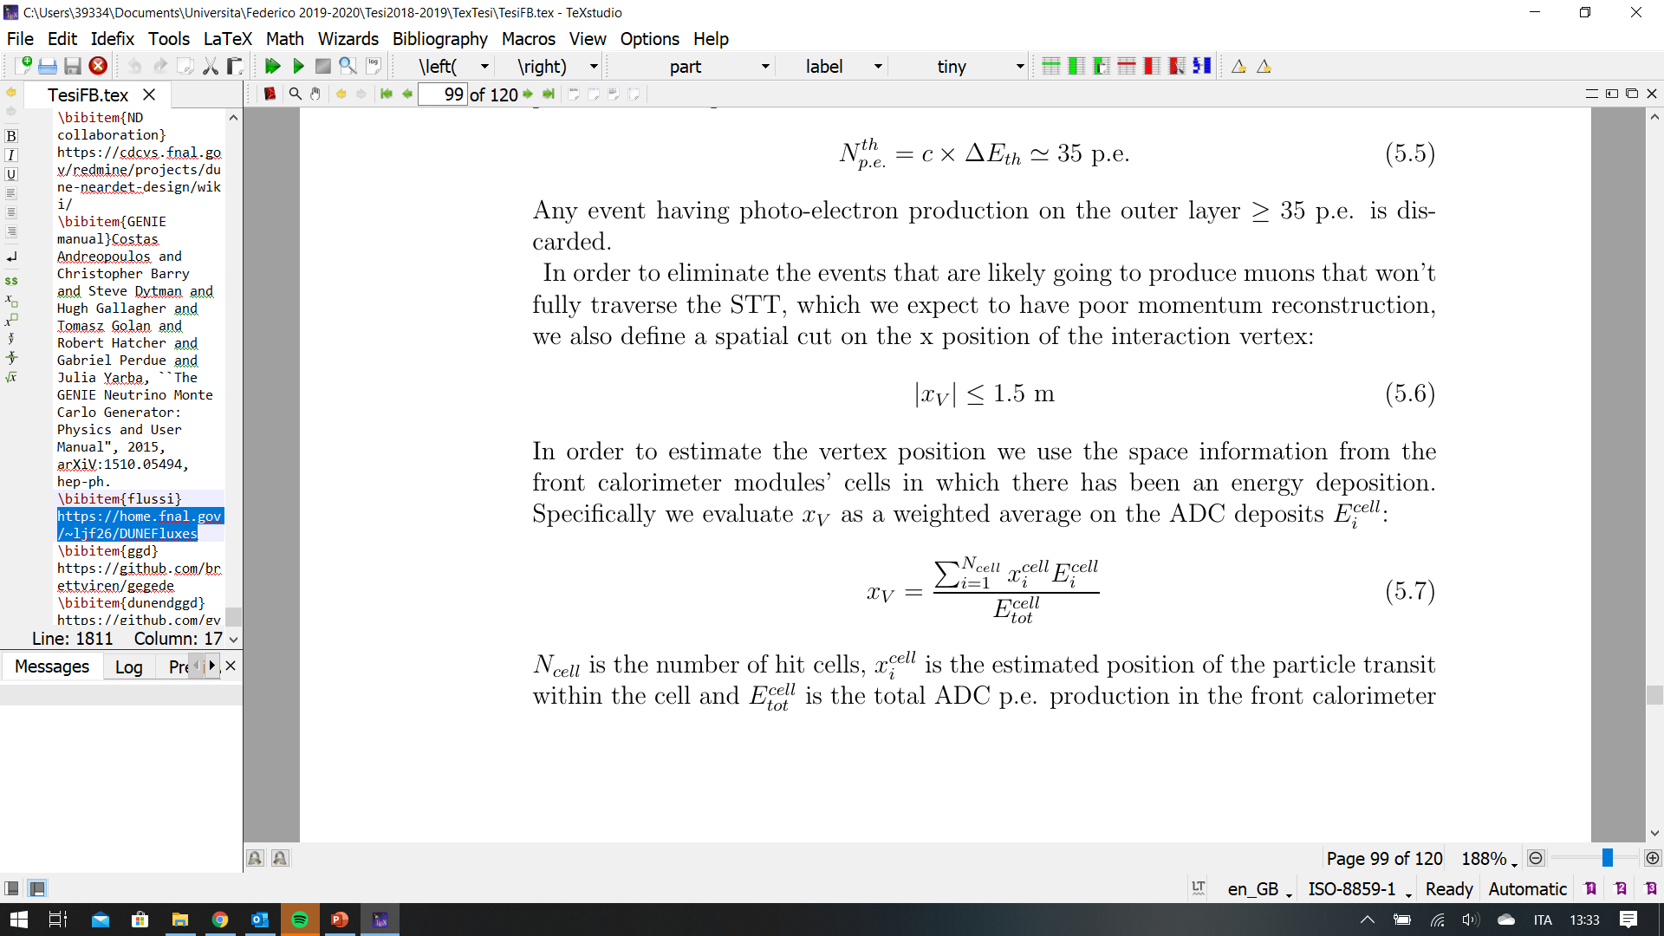
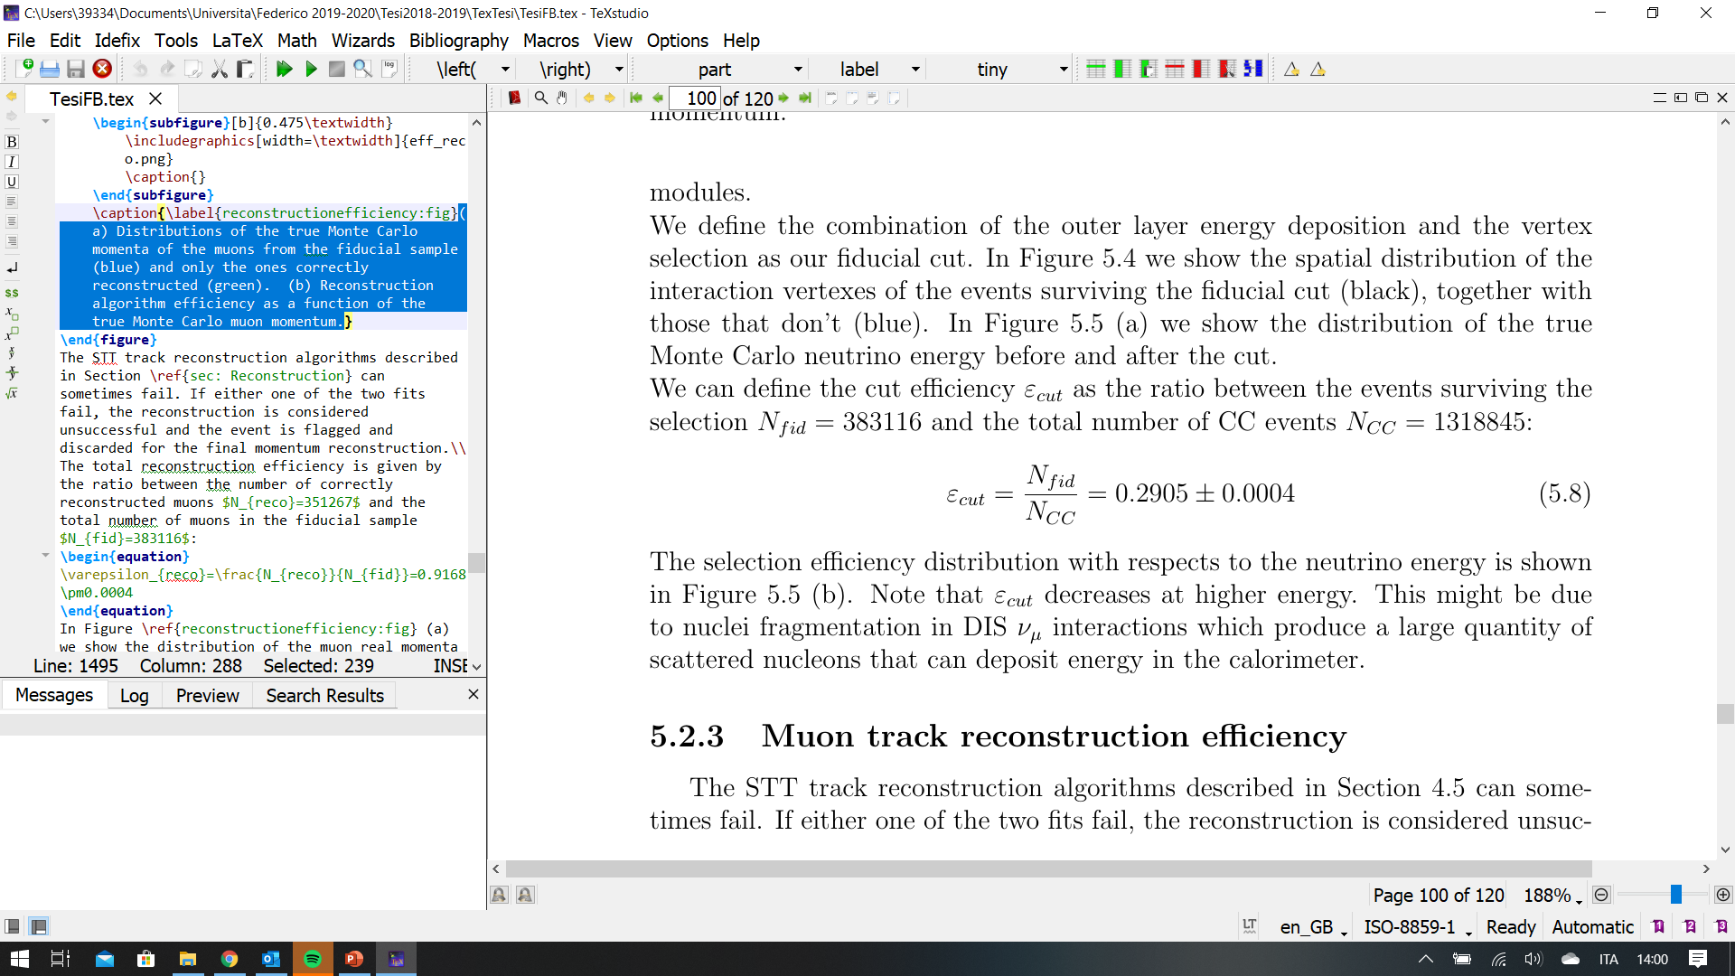
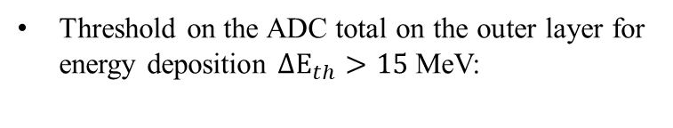
Fiducial cut
FIDUCIAL CUT: eliminate interactions outside SAND + muons not crossing the tracking system
Threshold on the ADC total on the outer layer for energy deposition $ΔE_{th}>15$MeV:
X interaction point, estimated as a weighted average on the energy deposition on the cells, is selected as:
Note: efficiency decreases at higher energy; might be due to nuclei fragmentation in DIS

Slide 15
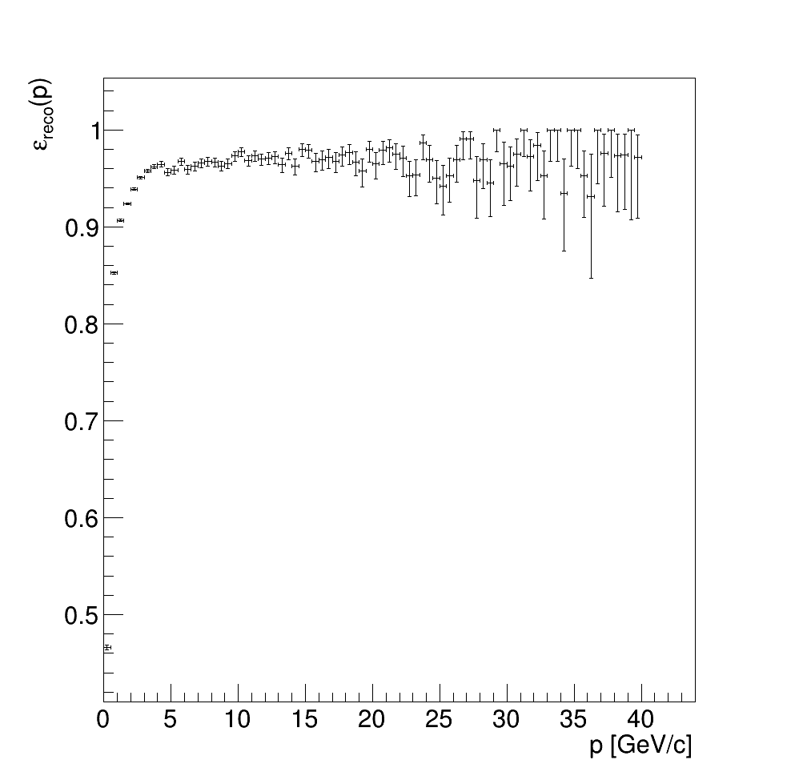






Muon Momentum reconstruction and quality cut
EFFICIENCY
Momentum reconstruction efficiency:
QUALITY

Slide 16


Chi-squared two-sample test statistics
To compare the distributions obtained from the nominal and shifted sample we use the test statistic:
Where k is the number of bins in the histograms and $u_{i}$and $v_{i}$ are their contents
T approximately follows a $χ^{2}$ distribution
Note: we call nominal and shifted the results obtained with standard and horn-1 displaced neutrino beam respectively

Slide 17






Preliminary ANALySiS
CHECK
T applied to the reconstructed momenta from two equal-size samples obtained from nominal beam.
$$p_{control}=0.527$$
$$σ_{control}=0.633$$
REFERENCE
T applied to the true Monte Carlo momenta from the nominal and shifted samples:
$$p_{truth}=5.15×{10}^{−7}$$
$$σ_{truth}=5.02$$

Slide 18






Results
T applied to nominal and shifted muon momenta samples after all cuts are applied:
Evolution of p-value with sample size
With a sample $>1.2×{10}^{6}$we identify the beam anomaly with a confidence level $≥3σ$

Slide 19

conclusions
DUNE will be a next generation neutrino oscillation Long Baseline accelerator experiment aiming at measuring CP violation and mass ordering
One essential component will be the beam monitoring (SAND) which will exploit KLOE’s magnet and e.m. calorimeter
In this thesis, I studied the beam monitoring capabilities of the SAND detector, comparing on a weekly basis the muon momentum distribution, from a sample in standard conditions (nominal) and one where an anomaly was introduced (shifted)
After defining a fiducial volume and quality selection SAND will be able to exclude the nominal beam hypothesis with a confidence level corresponding to $∼3.8σ$
With a sample $>1.2×{10}^{6}$we identify the beam anomaly with a confidence level $≥3σ$
The result can be improved:
Include neutrino interactions in the STT;
Optimize fiducial and quality cuts;
Consider also the possible modification of the shape of the beam studying the geometric distribution of interaction points;

